Slide 1

Geometry
Unit 11, Lesson 5 Interior and Exterior Angles of Triangles Volume 2, pg. 202

Slide 2


Benchmark
MA.912.GR.1.3
Prove relationships and theorems about triangles. Solve mathematical and real-world problems involving postulates, relationships, and theorems of triangles.
volume 2, pg. 202

Slide 3
Integrated Mathematical Thinking and Reasoning Standards
MA.K12.MTR.1.1 Actively participate in effortful learning both individually and collectively.
MA.K12.MTR.2.1 Demonstrate understanding by representing problems in multiple ways.
MA.K12.MTR.4.1 Engage in discussions that reflect on the mathematical thinking of self and others.
MA.K12.MTR.5.1 Use patterns and structure to help understand and connect mathematical concepts.
MA.K12.MTR.6.1 Assess the reasonableness of solutions.
volume 2, pg. 202

Slide 4

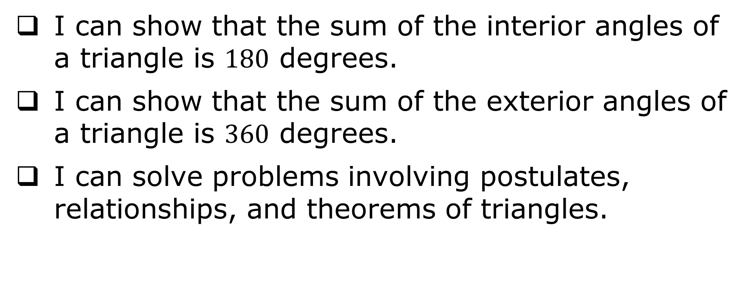
Learning Targets
I can show that the sum of the interior angles of a triangle is $180$ degrees.
I can show that the sum of the exterior angles of a triangle is $360$ degrees.
I can solve problems involving postulates, relationships, and theorems of triangles.
volume 2, pg. 202

Slide 5

Warm-Up
volume 2, pg. 202

Slide 6
11.5.1 Warm-Up: Superhero
If geometry had a superpower, it would be …
because …
Geometry’s villain would be …
because …
volume 2, pg. 202

Slide 7

Exploration
volume 2, pg. 203

Slide 8

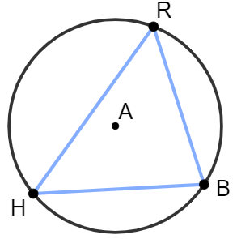
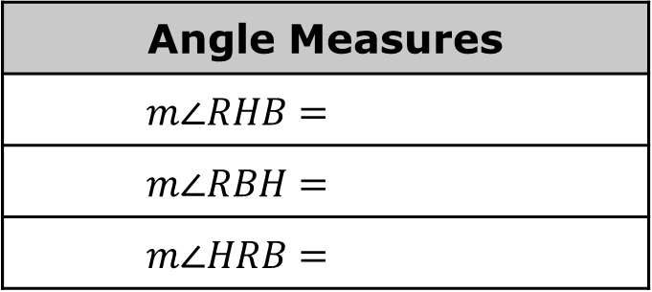

11.5.2 Exploration: Interior Angles of Triangles
Circle $A$ is shown, where $m\overset{⏜}{RB}=102°$, $m\overset{⏜}{BH}=108°$, and $m\overset{⏜}{HR}=150°$.
Complete the table.
What is the sum of the angles in $∆RBH$?
Angle Measures
$$m∠RHB=$$
$$m∠RBH=$$
$$m∠HRB=$$
volume 2, pg. 203

Slide 9
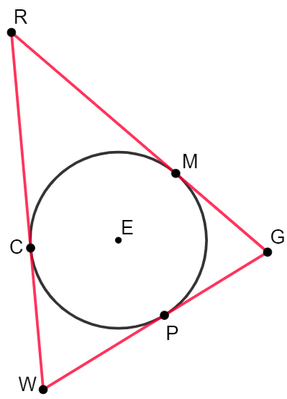
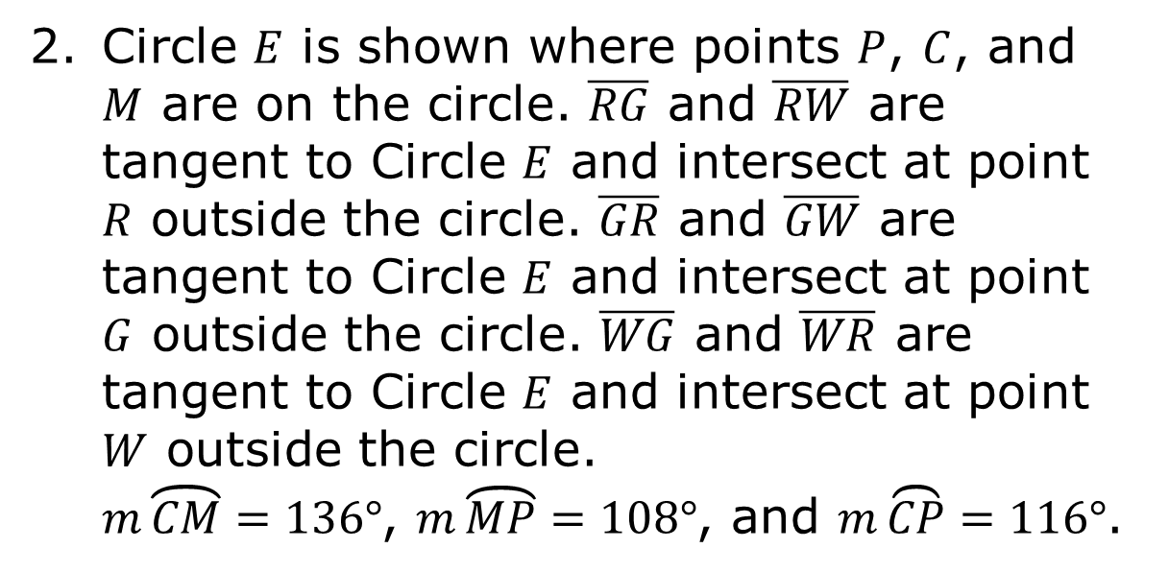
Circle $E$ is shown where points $P$, $C$, and $M$ are on the circle. $\overline{RG}$ and $\overline{RW}$ are tangent to Circle $E$ and intersect at point $R$ outside the circle. $\overline{GR}$ and $\overline{GW}$ are tangent to Circle $E$ and intersect at point $G$ outside the circle. $\overline{WG}$ and $\overline{WR}$ are tangent to Circle $E$ and intersect at point $W$ outside the circle.
$m\overset{⏜}{CM}=136°$, $m\overset{⏜}{MP}=108°$, and $m\overset{⏜}{CP}=116°$.
volume 2, pg. 203

Slide 10
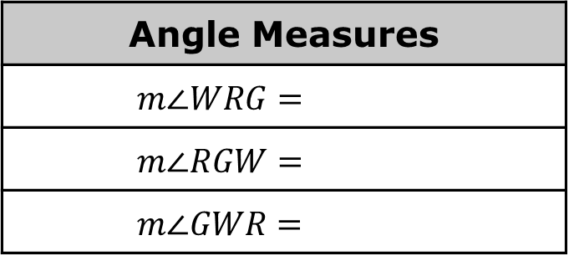

Complete the table.
What is the sum of the angles in $∆RGW$?
Write a conjecture about the sum of the interior angles of a triangle.
Angle Measures
$$m∠WRG=$$
$$m∠RGW=$$
$$m∠GWR=$$
volume 2, pg. 203

Slide 11
Ask two classmates for their conjectures. Record their conjectures and write your summary of their reason. You are the only person who should write in the first two columns of the table. Have the person initial next to your summary stating that your summary was correct.
Conjecture | My Summary of Their Reason | Initials
volume 2, pg. 204

Slide 12

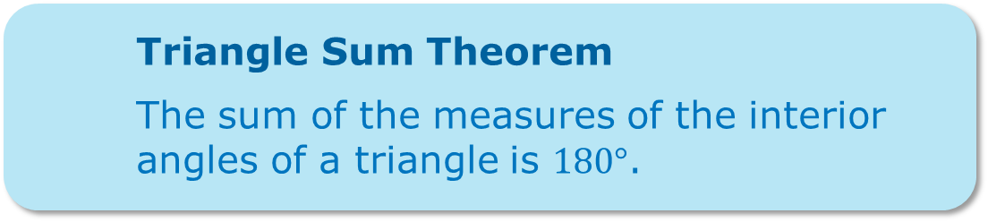
Review your conjecture with your partner. If necessary, make any changes.
Triangle Sum Theorem
The sum of the measures of the interior angles of a triangle is $180°$.
volume 2, pg. 204

Slide 13

Activity
volume 2, pg. 204

Slide 14

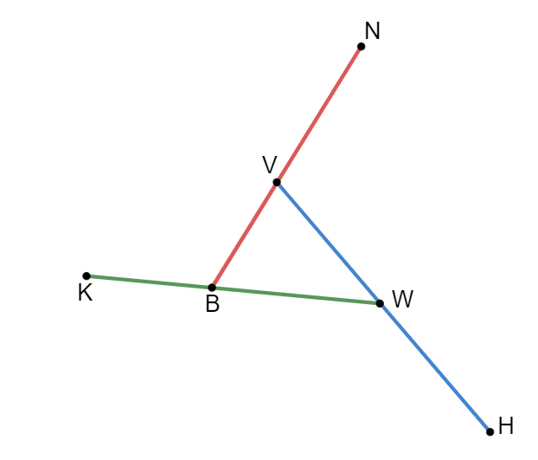
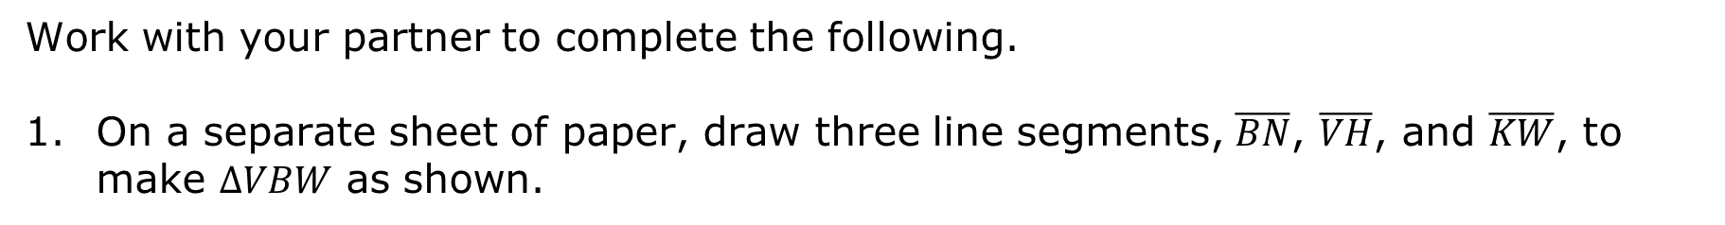
11.5.3 Activity: Exterior Angles of Triangles
Work with your partner to complete the following.
On a separate sheet of paper, draw three line segments, $\overline{BN}$, $\overline{VH}$, and $\overline{KW}$, to make $∆VBW$ as shown.
volume 2, pg. 204

Slide 15

List the exterior angles of $∆VWB$.
Estimate the sum of the exterior angles of $∆VWB$.
An exterior angle is an angle created by extending one leg of a triangle.
volume 2, pg. 204

Slide 16
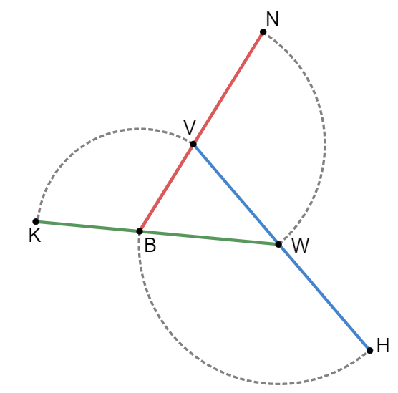
Use a compass to draw arc $\overset{⏜}{BH}$ using point $W$ as the center, $\overset{⏜}{KV}$ using point $B$ as the center, and $\overset{⏜}{NW}$ using point $V$ as the center, as shown.
Trace the figure above onto patty paper and cut out each sector. Rearrange the sectors to determine the sum of the exterior angles.
What do you notice about the sum of the exterior angles of the triangle?
Write a conjecture about the sum of the exterior angles of a triangle.
volume 2, pg. 205

Slide 17
Ask two classmates for their conjectures. Record their conjectures and write your summary of their reason. You are the only person who should write in the first two columns of the table. Have the person initial next to your summary stating that your summary was correct.
Review your conjecture with your partner. If necessary, make any changes.
Conjecture | My Summary of Their Reason | Initials
volume 2, pg. 205

Slide 18

Guided Practice
volume 2, pg. 206

Slide 19

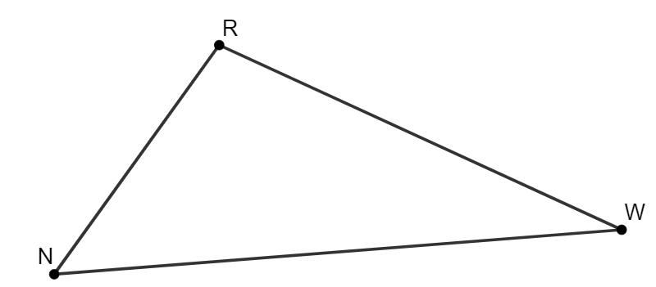
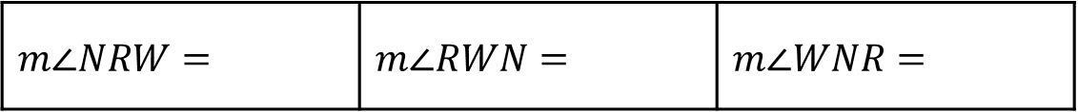
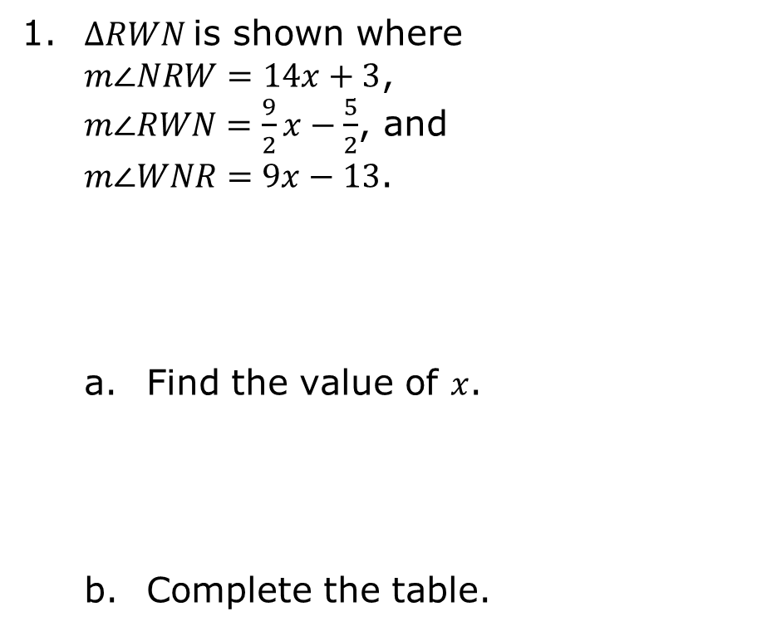
11.5.4 Guided Practice: Interior and Exterior Angles of Triangles
1. $∆RWN$is shown where $m∠NRW=14x+3$, $m∠RWN=\frac{9}{2}x−\frac{5}{2}$, and $m∠WNR=9x−13$.
Find the value of $x$.
Complete the table.
$$m∠NRW=$$ | $$m∠RWN=$$ | $$m∠WNR=$$
volume 2, pg. 206

Slide 20
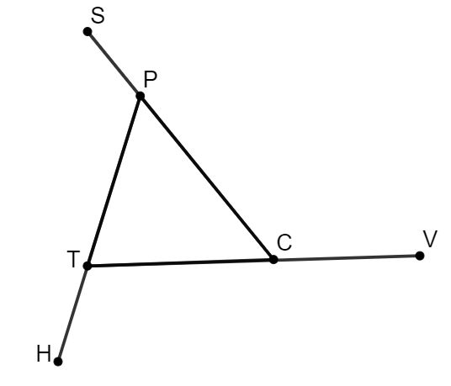

$∆PCT$ is shown, where $∠SPT$, $∠PCV$, and $∠HTC$ are exterior angles. $m∠PCT=52°$, $m∠SPT=(11x−20)°$, and $m∠HTC=(8x+5)°$.
Find the value of $x$.
What is the measure of $∠SPT$?
What is the measure of $∠HTC$?
volume 2, pg. 206

Slide 21

Wrap-Up
volume 2, pg. 207

Slide 22
11.5.5 Wrap-Up: Cool Down
Write a summary of what you learned in this lesson.
volume 2, pg. 207

